Slide 1
RelAtıonshıp of ACADEMIC INTENSITY AND HEALTH METRICS
MUSA ERAY AKALIN
32242

Slide 2
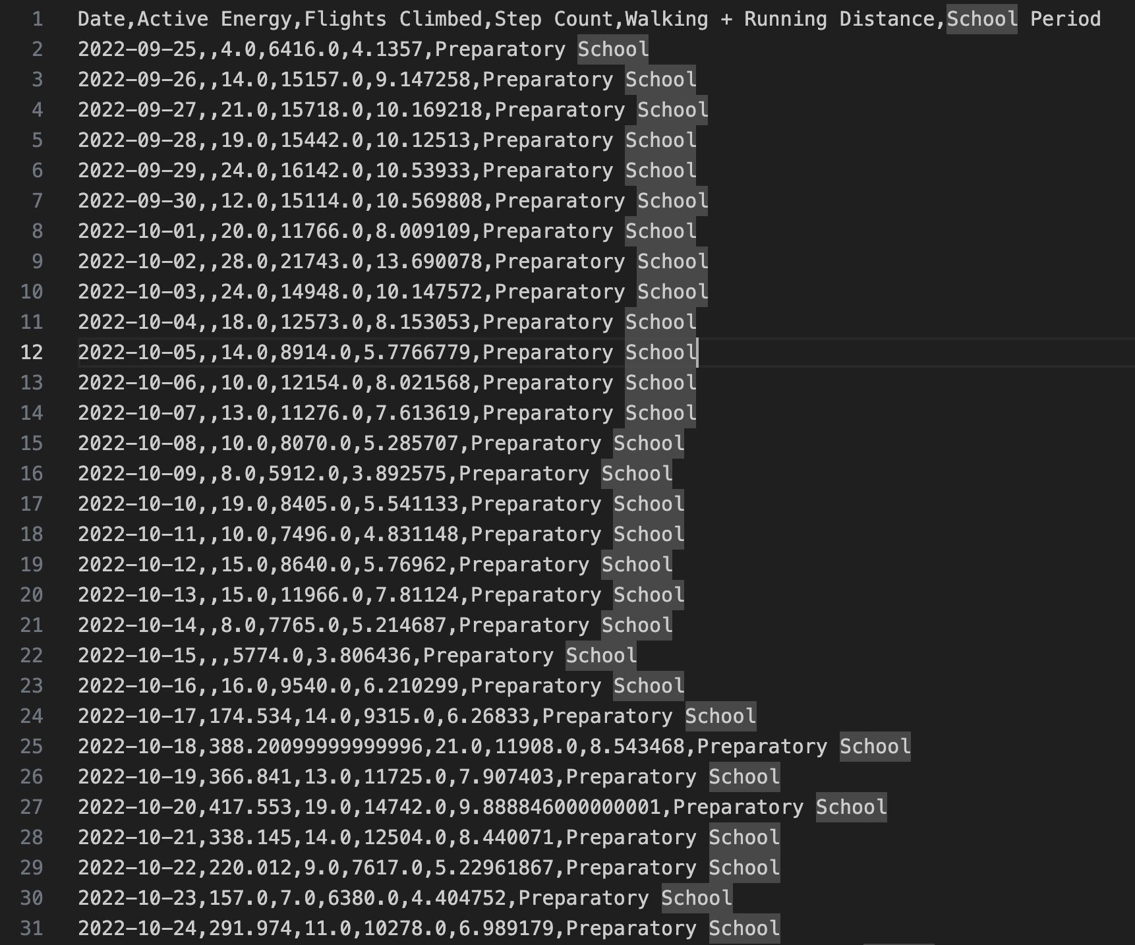
Data preprocessıng
I preprocessed the raw data(XML file) collected from Apple Health to clean and structure it into an organized CSV format. This process made subsequent implementations and calculations on the data more convenient.
The raw XML data from the Apple Health app was processed and organized into structured CSV files. Relevant metrics were extracted using xml.etree.ElementTree and organized in a pandas DataFrame, with dates converted for easier manipulation. Daily totals and averages were calculated, and the data was filtered into academic periods. The final dataset, structured by school periods, was exported as a CSV for further analysis.

Slide 3
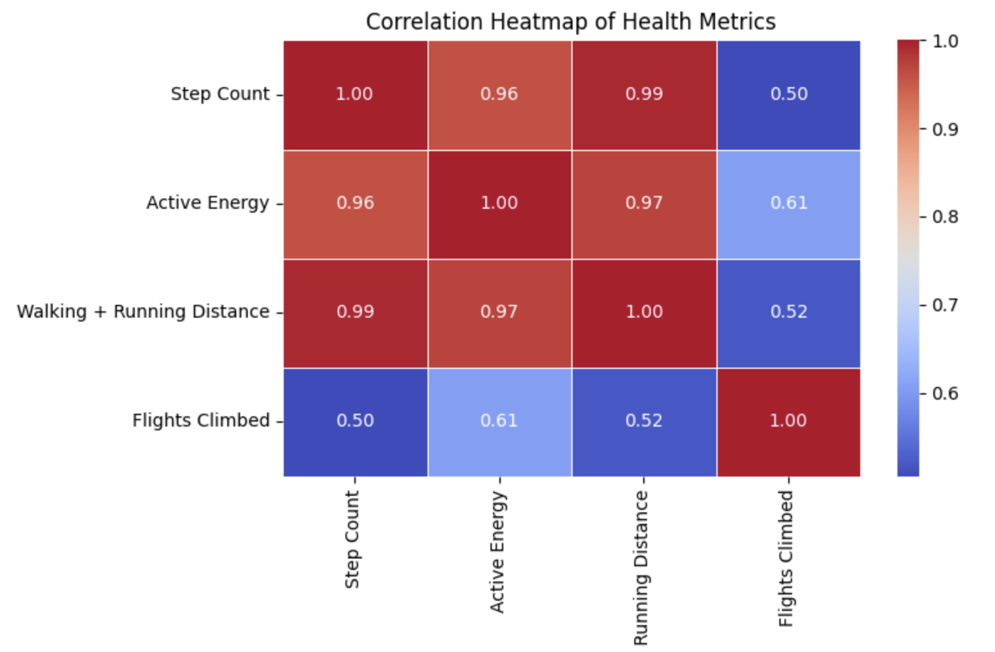
Correlatıon matrıx
After structuring the data, I analyzed correlations between metrics such as step count, distance, flights climbed, and energy burned. To do this, I created a correlation matrix for deeper investigation.
The correlation heatmap reveals strong positive relationships between Step Count, Walking + Running Distance (+0.90), and Active Energy (+0.85). Walking Distance and Active Energy are also closely linked (+0.88). Flights Climbed shows weaker correlations (+0.60), indicating it represents a distinct activity. No negative correlations were observed, highlighting consistency in activity trends. Step Count emerges as a central metric, while Flights Climbed reflects a specific aspect of physical activity, guiding further analysis into energy expenditure and stair-climbing patterns.

Slide 4
DATA ANALYSIS
I hypothesize that my step count decreases as academic workload increases. To test this, I formulated a null hypothesis stating that academic intensity has no significant impact on my step count, and an alternative hypothesis suggesting that increased academic intensity leads to a reduction in step count. To evaluate these hypotheses, I employed pairwise two-sample t-tests as the method of analysis.
Two-tailed t-tests are suitable for analyzing the relationship between academic workload and step count because they evaluate the possibility of any significant change, whether an increase or decrease. This approach ensures an unbiased analysis, offering a comprehensive assessment of the impact of academic intensity on physical activity levels.

Slide 5
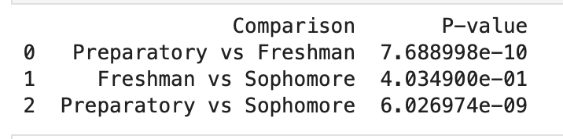
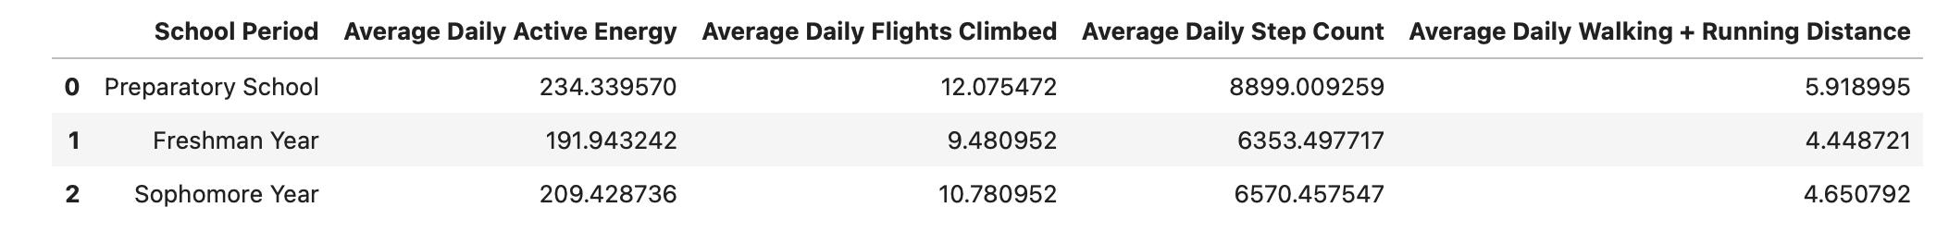
RESULTS OF T-TEST
The analysis shows a significant decline in step counts from Preparatory School to both Freshman and Sophomore years (p-value < 0.001), highlighting a sharp drop in physical activity with the transition to faculty. However, the lack of significant change between Freshman and Sophomore years (p-value = 0.403) suggests that activity levels stabilize after the initial decline, likely due to lifestyle adjustments or evenly increased academic demands.

Slide 6
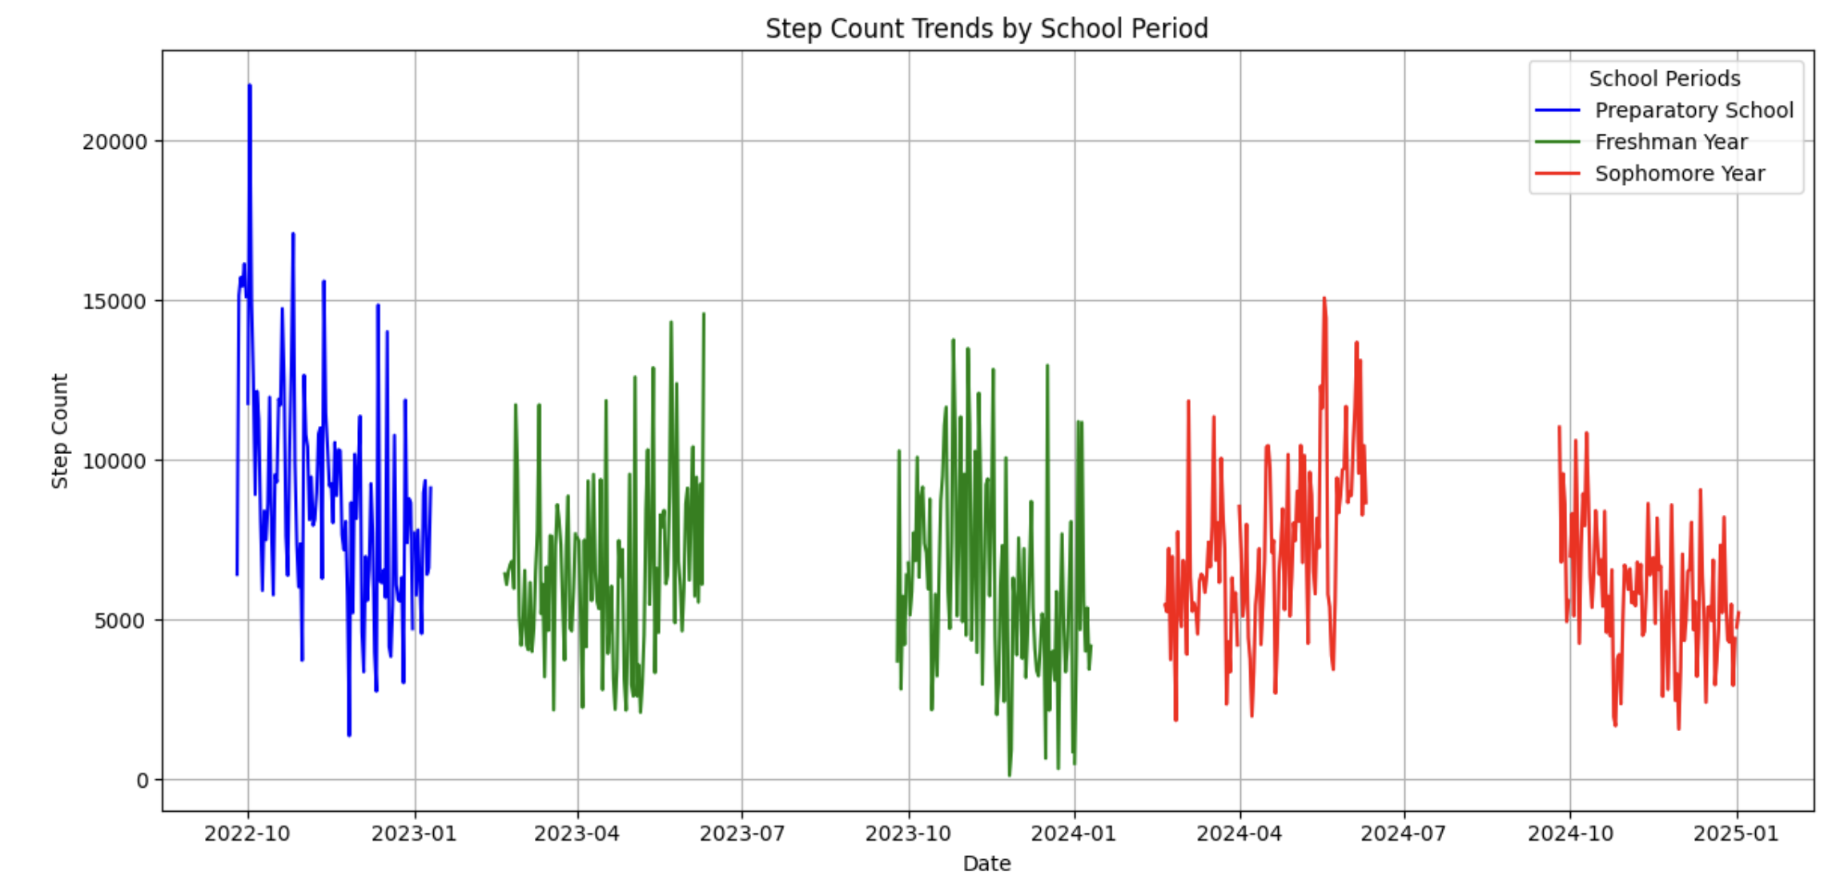
DATA VISUALIZATION
Exploratory Data Analysis (EDA) techniques, including box plots, bar charts, histograms, scatter plots, and heatmaps, were employed for in-depth data analysis. Additionally, linear regression models were utilized to predict metrics for the junior year.

Slide 7
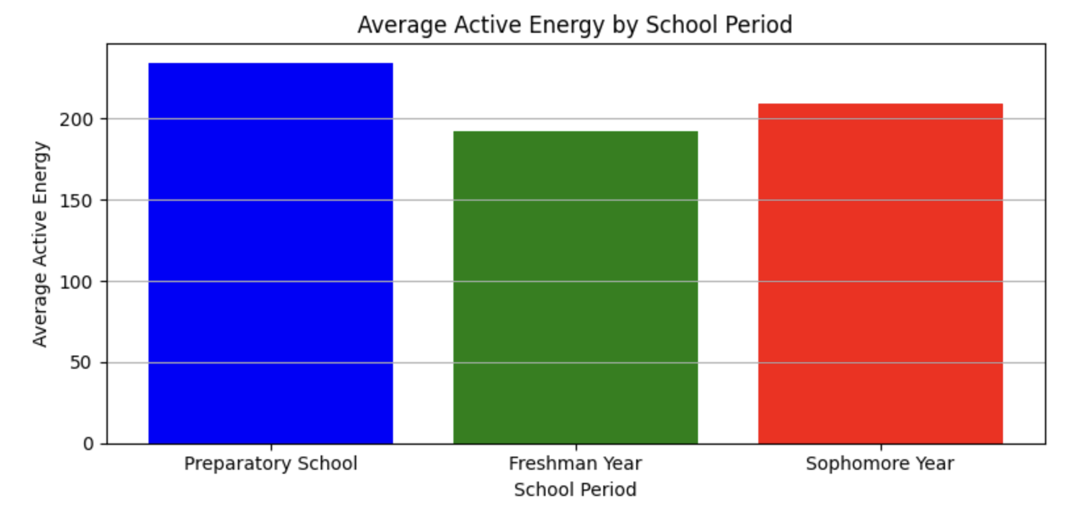
Actıve energy comparıson by each school perıod
Surprisingly, the average active energy and step count during the the sophomore year is slightly higher than in the freshman year, possibly due to an increased pace of life.

Slide 8
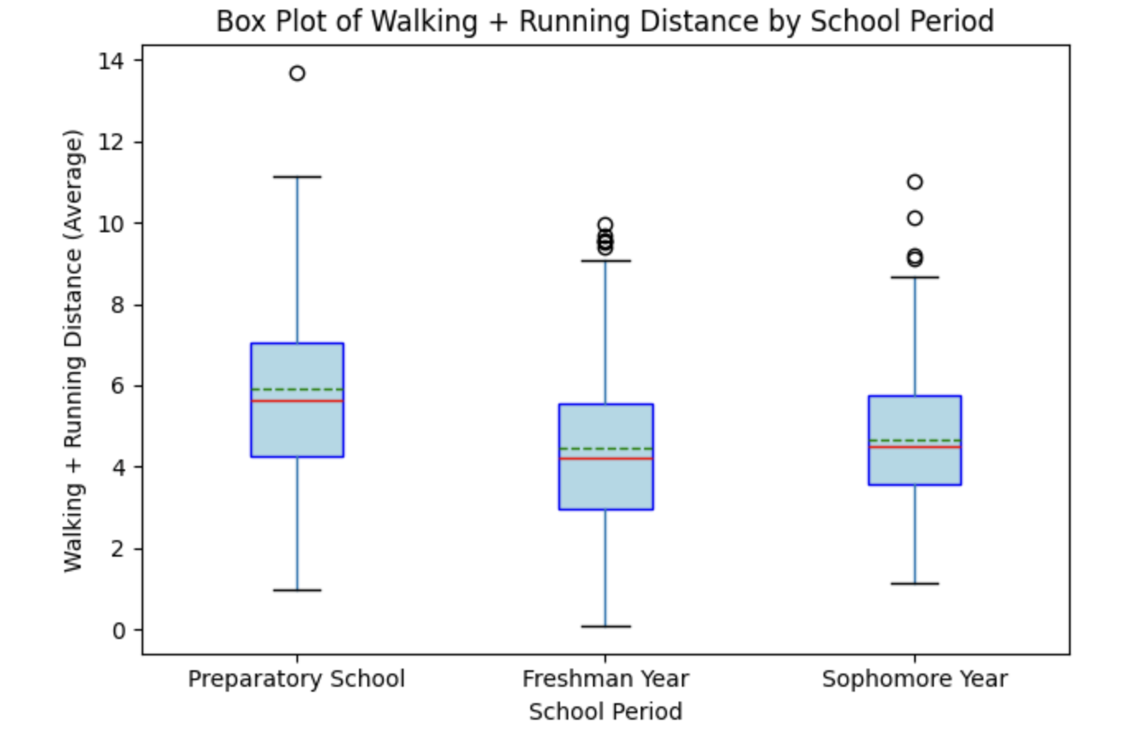
Box plot of runnıng and walkıng dıstance metrıc
The box plot shows a decline in walking and running distance from Preparatory School to Freshman Year, with the median stabilizing during Sophomore Year. Preparatory School has the highest median and least variability, while Freshman and Sophomore years show greater variability and outliers, indicating occasional spikes in activity. This highlights reduced and more inconsistent physical activity after transitioning to university. Its similarity between step count is observable as expected

Slide 9
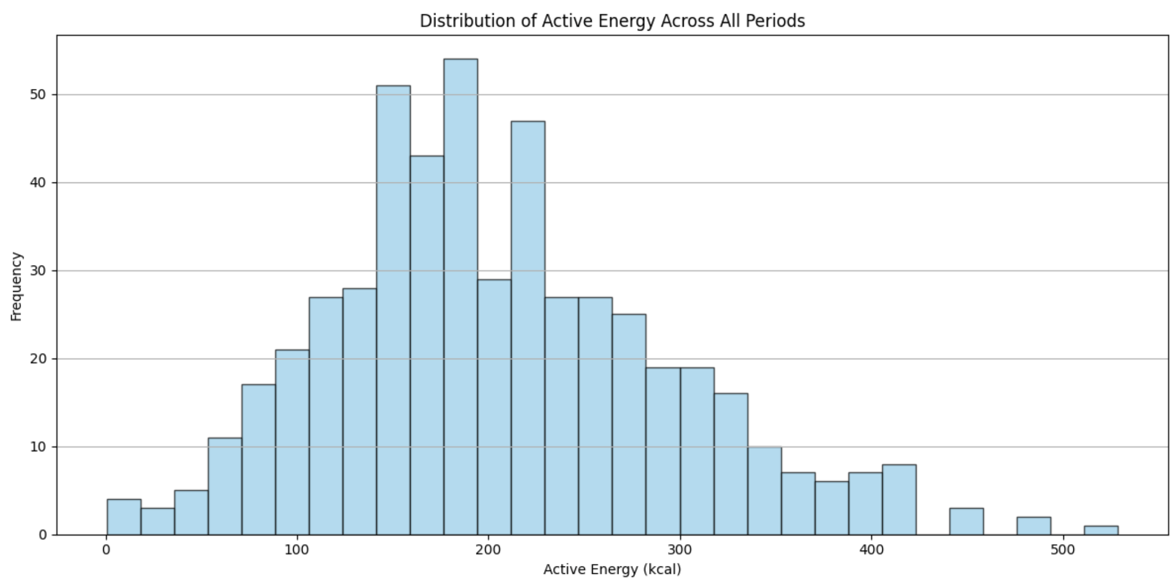
HISTOGRAM OF ACTIVE ENERGY
This histogram illustrates the distribution of active energy (kcal) across all periods. The data appears roughly bell-shaped, indicating a normal distribution with a peak around 200 kcal. Most values are concentrated between 100 and 300 kcal, showing that moderate energy expenditure is common. Outliers on the higher end (above 400 kcal) represent days of significantly higher activity. The distribution highlights typical daily energy expenditure patterns, with a gradual decline as active energy levels increase.

Slide 10
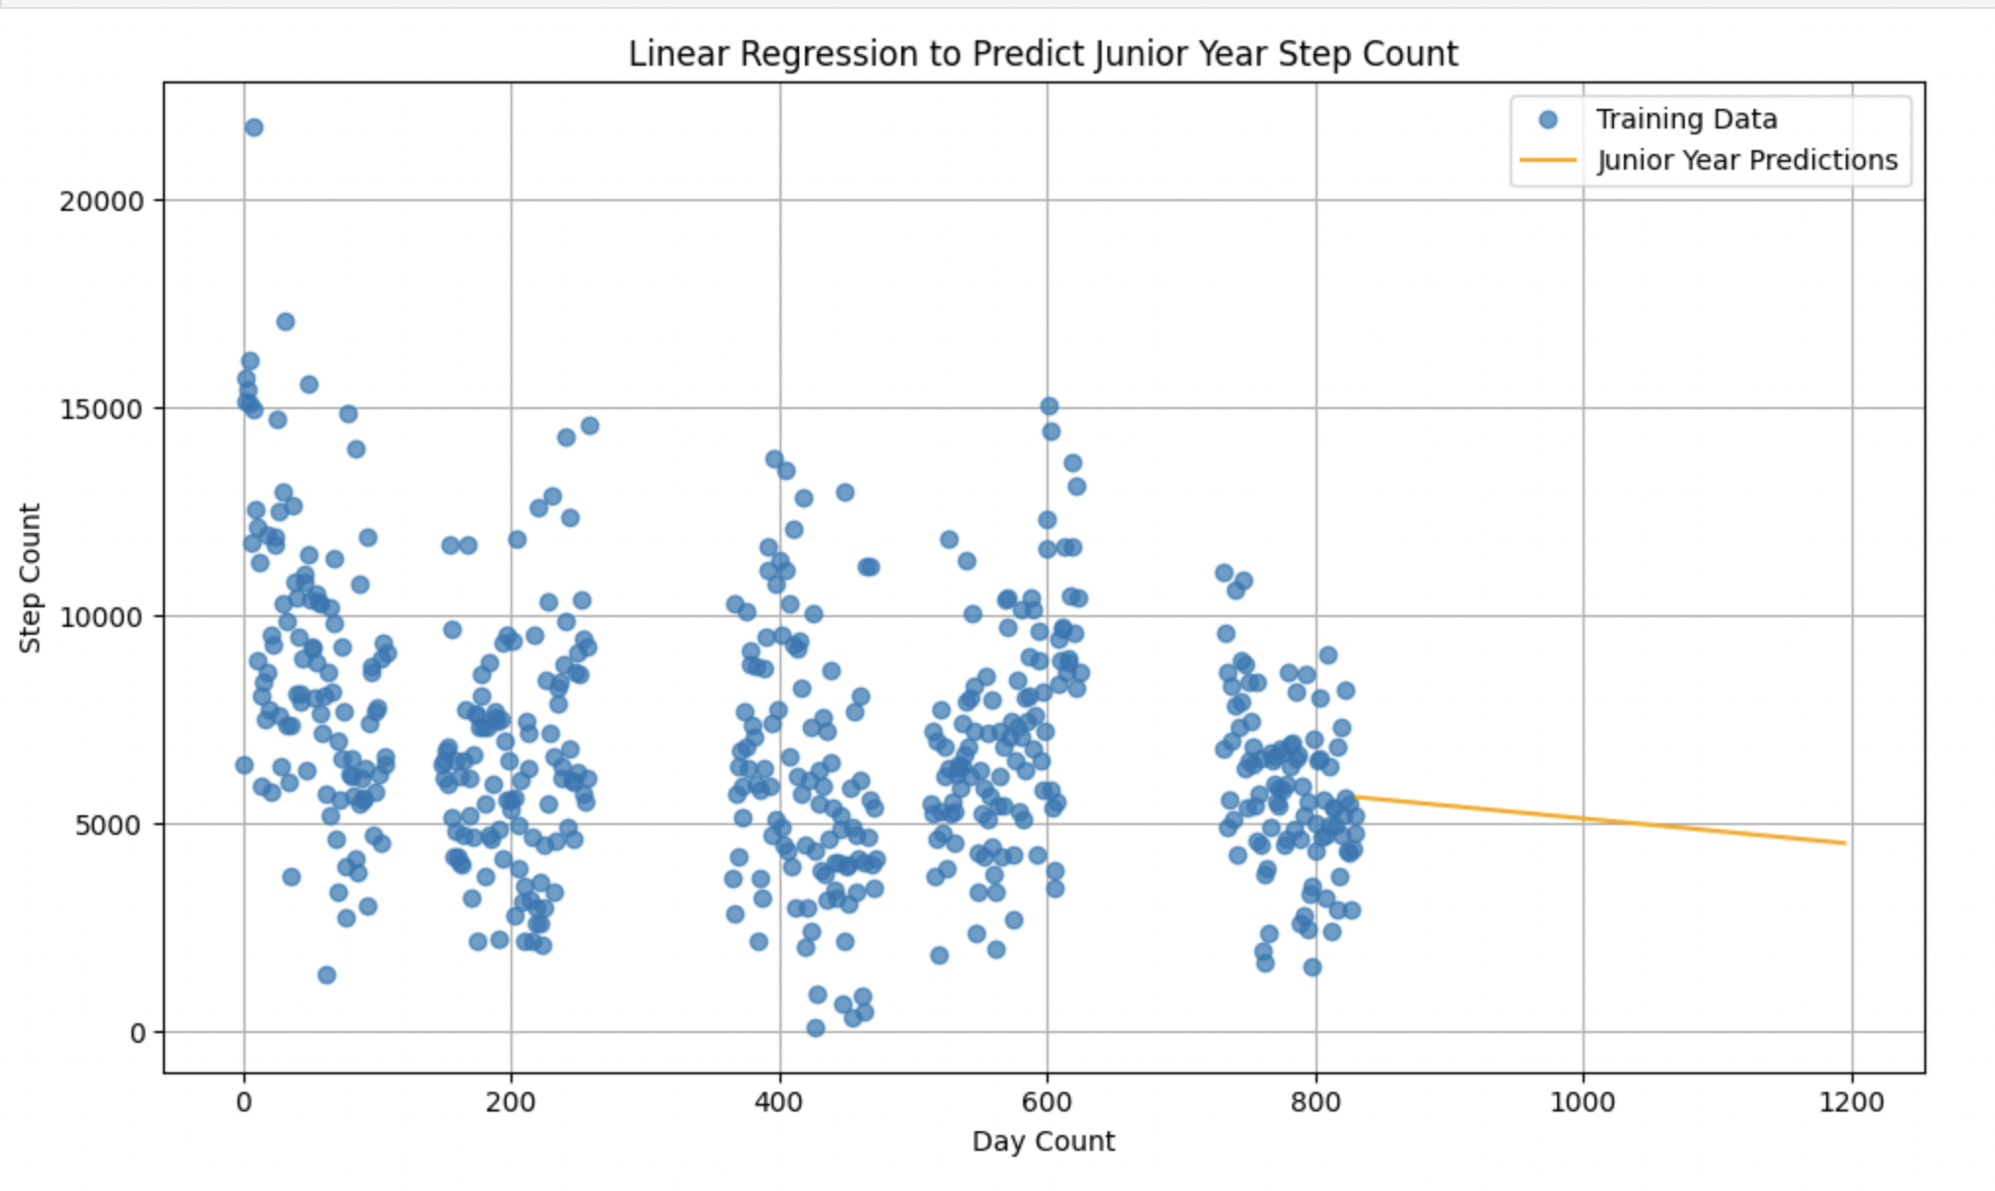
Lınear reggessıon to predıct junıor year step count
The graph presents step count data and predictions. Actual data from Preparatory School, Freshman Year, and Sophomore Year is displayed as a scatter plot, serving as training data for a linear regression model. The orange line represents the predicted trend for Junior Year, indicating stable or slightly declining step count levels. This suggests that physical activity, as measured by step count, is likely to remain consistent or decrease slightly unless significant lifestyle changes occur.

Slide 11
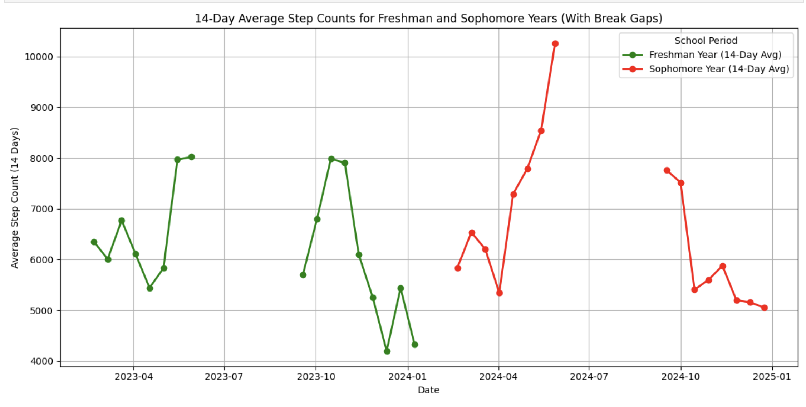
Addıtıonal observatıons on step count metrıc
Using 14-day average step counts, I wanted to analyze the impact of exam weeks on my mobility. I encountered with seasonal effects according to my dataset. Observations reveal a substantial drop in step count at the end of the fall terms during both Freshman and Sophomore years. In contrast, a significant increase in step count is observed at the end of the spring terms for the same periods.

Slide 12
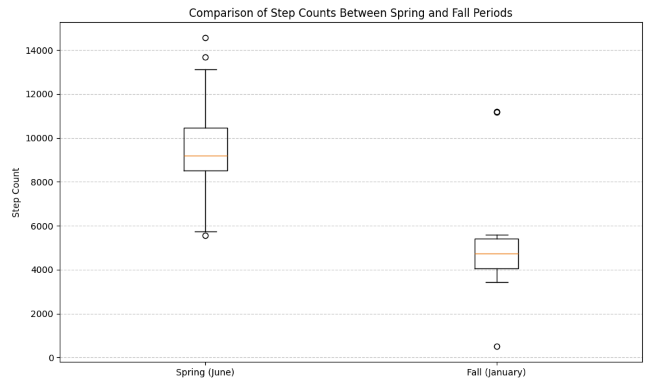
Addıtıonal observatıons on seasonal ımpacts
These boxplots also suggest that external factors like weather conditions could influence physical activity, similar to how academic intensity affects it. Despite the final week, in spring term step count tend to increase substantially in all academic semesters.

Slide 13
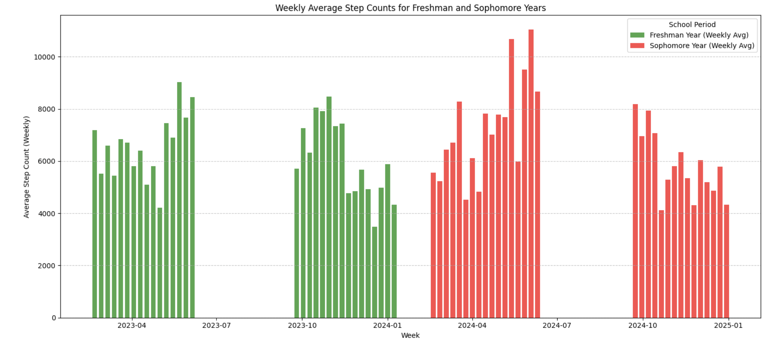
To analyze the impact of exam weeks, I created a bar chart on weekly averages this time

Slide 14
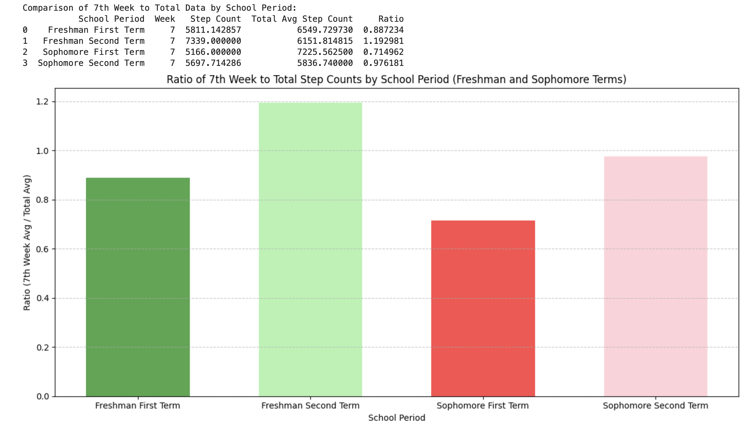
IMPACT OF APPROXIMATE MIDTERM WEEK

Slide 15
AnalysIs of MIdterm Week Step Counts
Step counts during fall term midterm weeks are significantly lower than the period averages, likely due to increased academic workload. In contrast, spring term midterm weeks show higher step counts, potentially due to better weather encouraging both indoor and outdoor activities. However, a decline in step counts across spring terms indicates the impact of rising academic pressure on physical activity. This analysis highlights seasonal variations and the influence of academic workload on step counts.

Slide 16
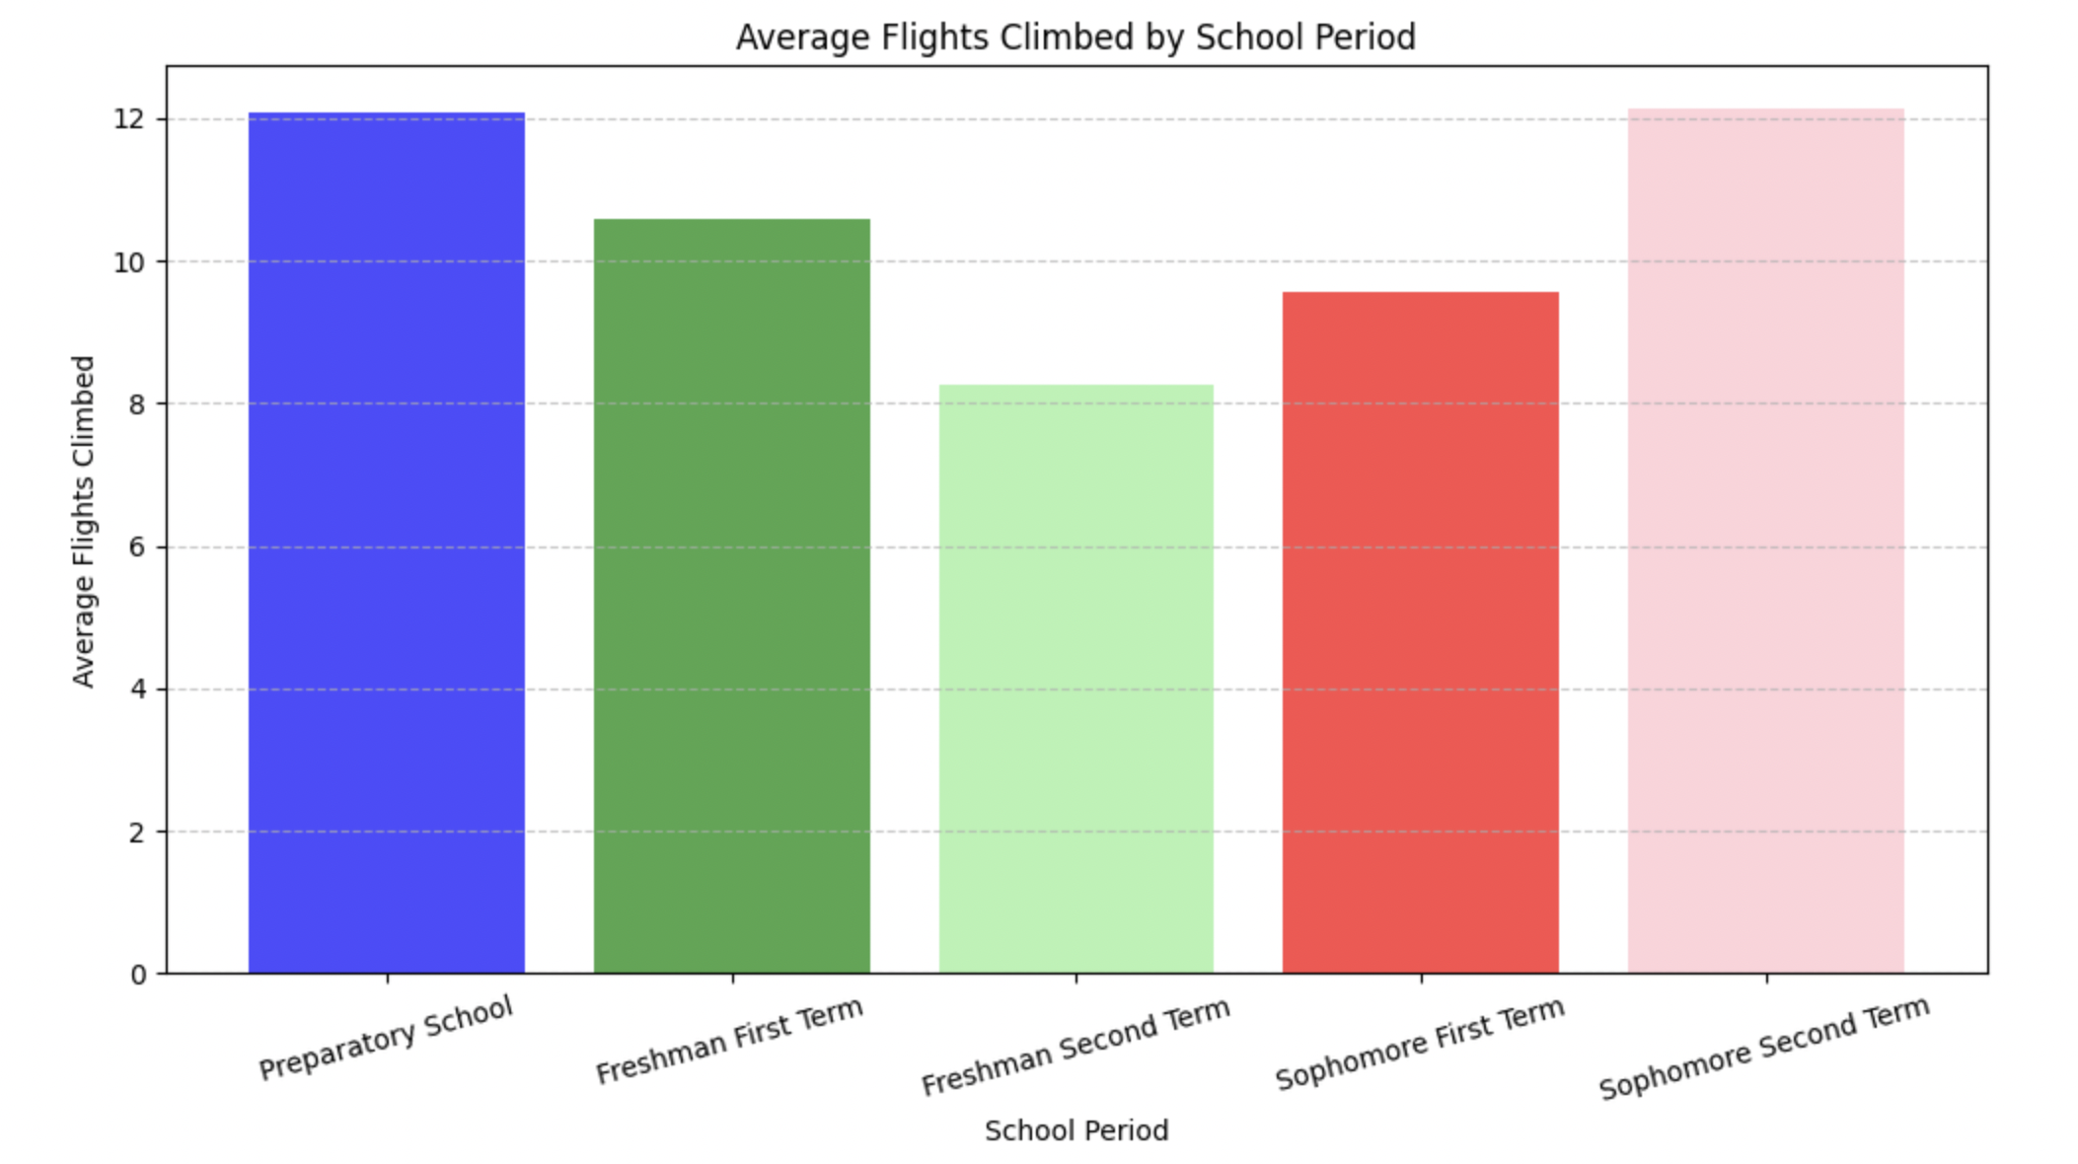
Analysıs of flıghts clımbed metrıc

Slide 17
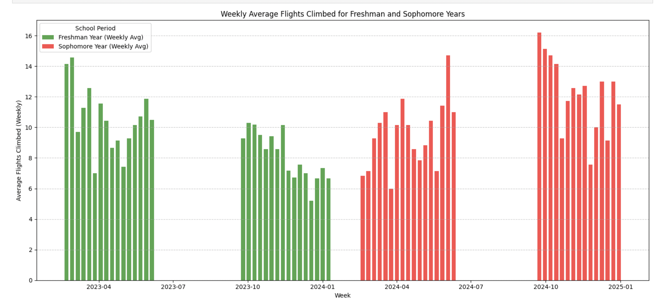

Slide 18
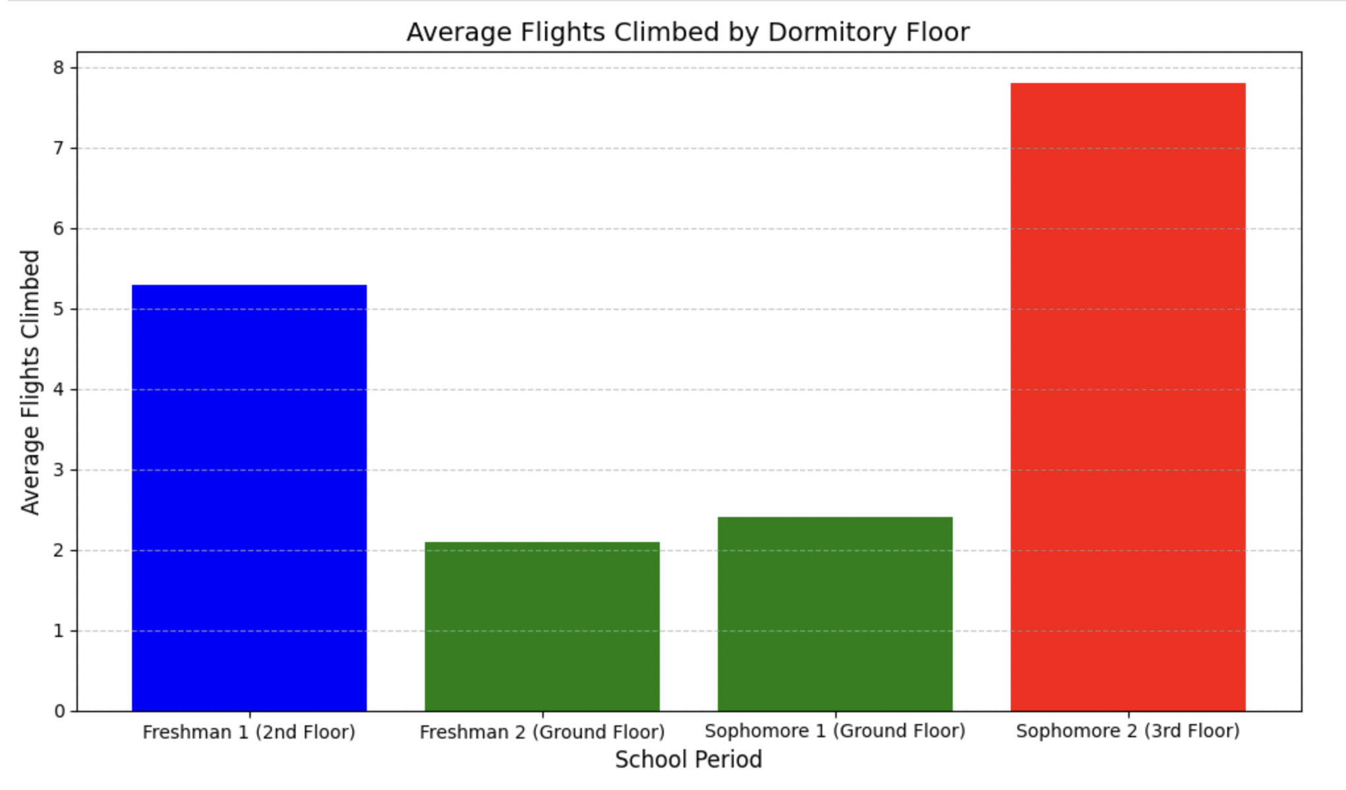
Observatıons on flıghts clımbed
The analysis shows a strong correlation between dormitory floor level and average flights climbed. Living on higher floors, such as the 2nd floor during Freshman 1 (5.3 flights) and the 3rd floor during Sophomore 2 (7.8 flights), led to significantly higher stair usage. In contrast, living on the ground floor during Freshman 2 and Sophomore 1 resulted in minimal stair usage, with averages of 2.1 and 2.4 flights, respectively. This highlights how dormitory arrangements influence daily physical activity and overall health-related metrics.

